Slide 1
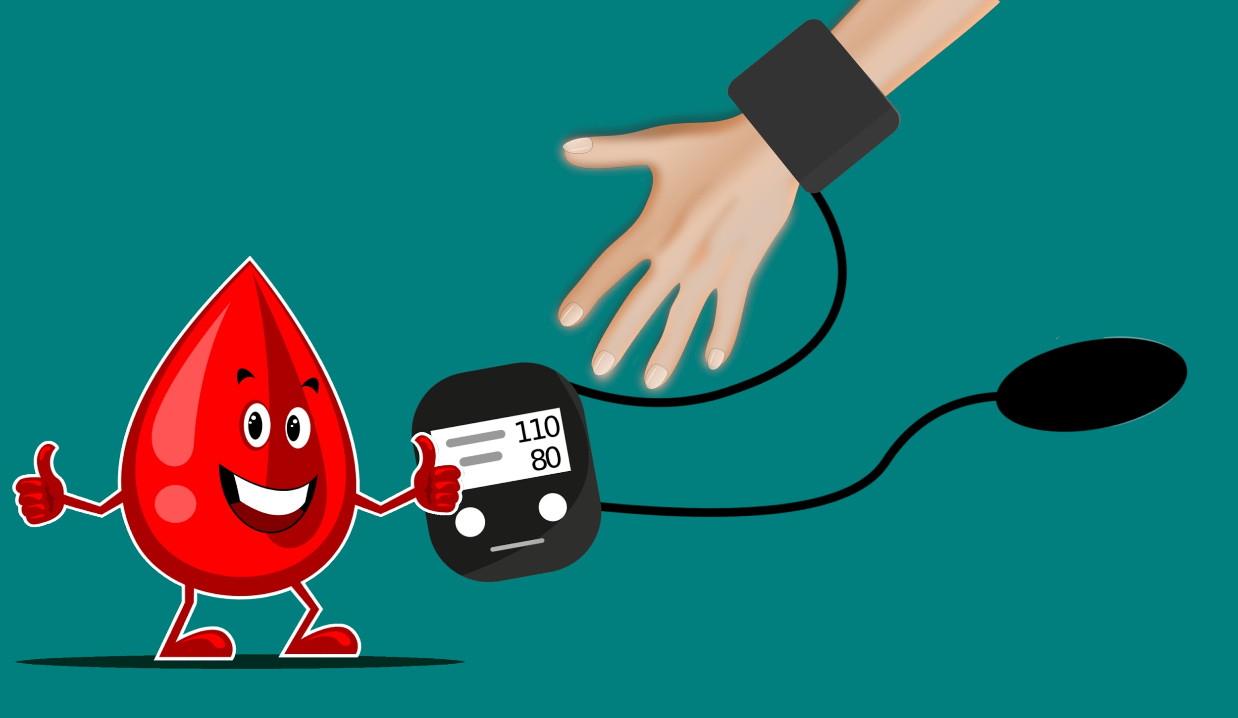
13.1 Health and its Failure

Slide 2
Factors to achieve good health
Balanced diet
Proper exercise
Good hygiene and
Cleanliness
Freedom from
Stress:
healthy family relations
presence of friends to share
sufficient sleep

Slide 5
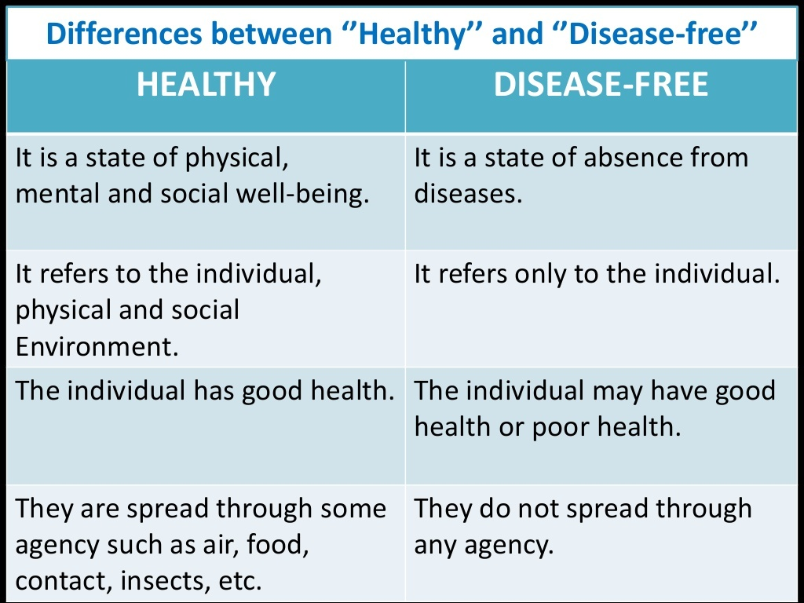

Slide 7
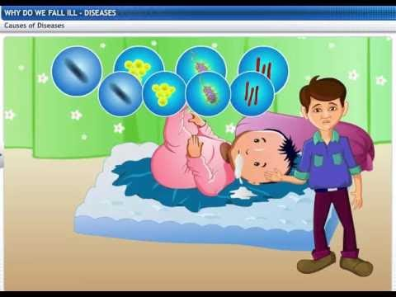
/Contagious

Slide 8
Notes:
What are acute diseases? They are the diseases which are of short duration.

Slide 19
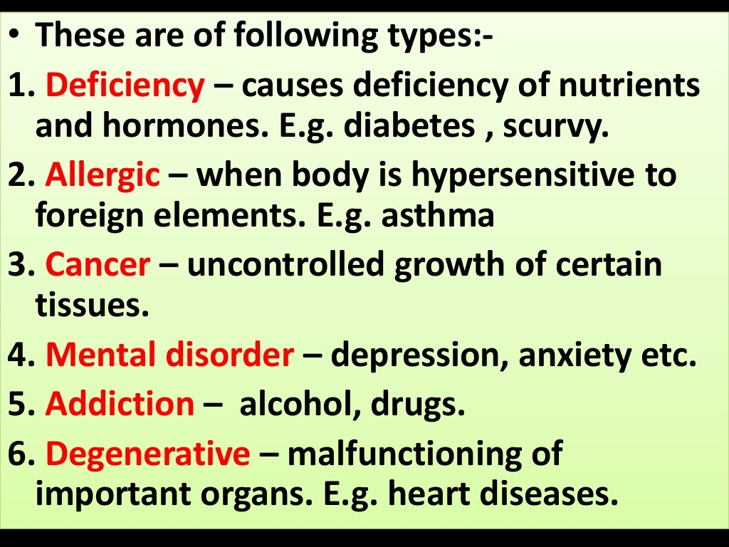

Slide 21
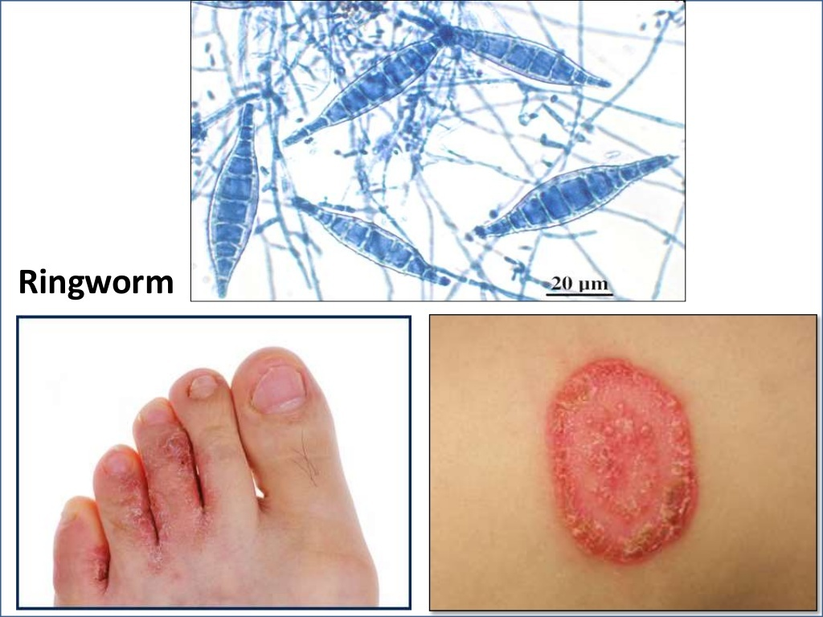

Slide 22
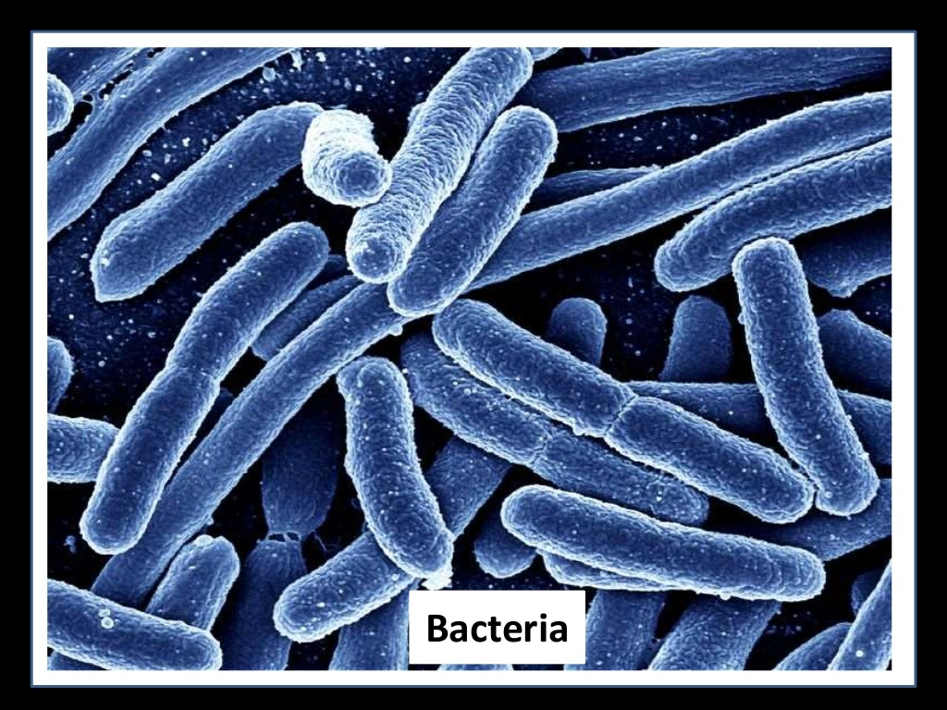

Slide 24
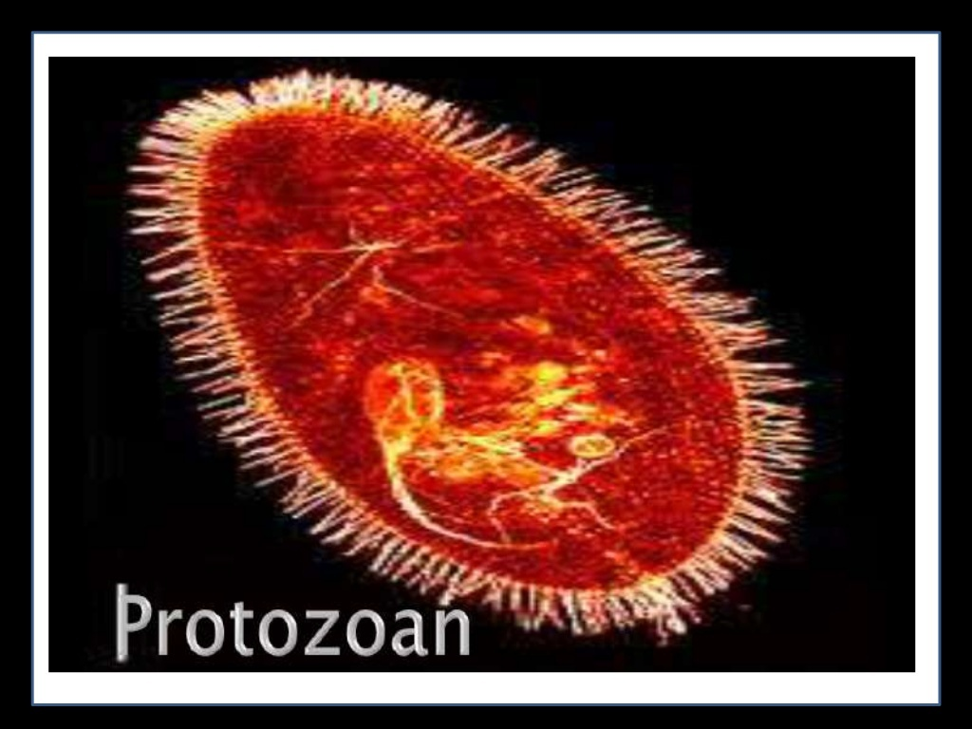

Slide 25
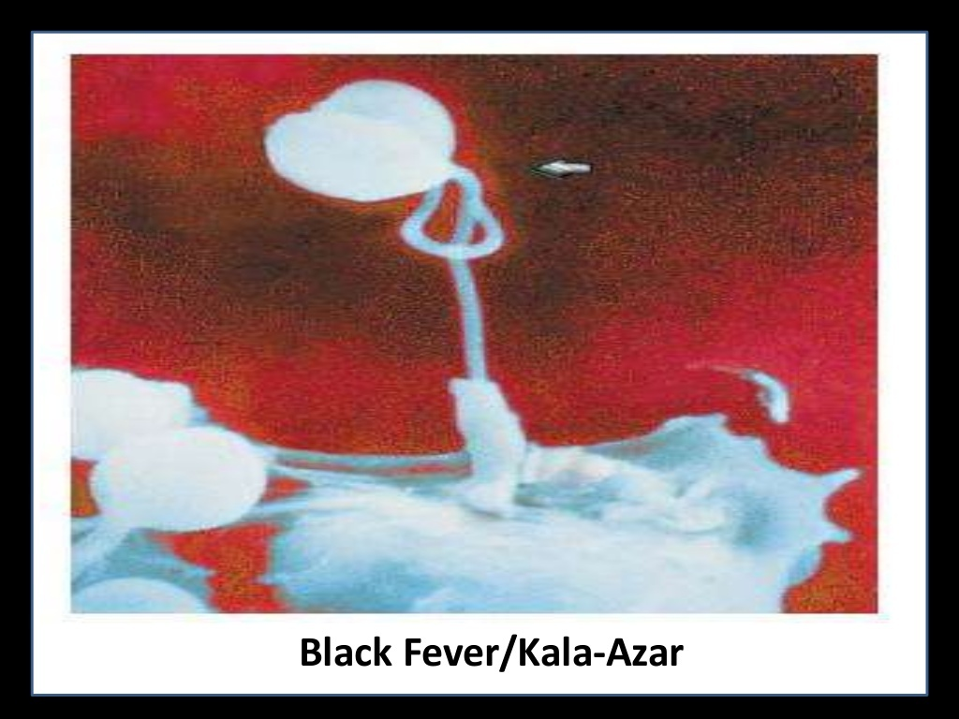

Slide 26
